Slide 1
LAN Admin Meeting
January 16, 2014

Slide 2
Agenda
Agenda Item
Recap of Recent Issues
SBAC/Common Core
Technology Bond
iPad Cart Options
Project Updates
Security/Systems Administration

Slide 3
SBAC/Common Core
Team Meeting (Ed Services/IT) Every 2 Weeks
Significant Additional Details Being Released Later this Month
Site Readiness Reminders
TRT Response
Testing Environment –
Computers Meeting Min. Standards
Headphones
Communicate with IT in Advance if You Plan on Using Mobile Devices

Slide 4
Recap of Recent Issues
Help Desk
New Year’s Eve Outage
Iusd.org Outage
Needed Time: Office 365 Setup

Slide 5
Technology Bond
Technology Plan adopted by the Board 12/10/13
Presented Bond Financing Options 1/14/14
Feasibility/Tracking Poll Underway
Key Decisions February and March Board Meetings

Slide 6
Bond Summary Information
Description | 10-Year | 15-Year
Estimated Bond-Eligible Need (Derived from Tech Plan) | $69.2 Million | $101.2 Million
Bond Financing Options – Estimated Project Funds
$19 | $61.6 Million | $105.8 Million
$24 | $78.8 Million | $135.3 Million
$29 | $95.9 Million | $163.8 Million

Slide 7
iPad Cart Options

Slide 8
Project Updates
Projector Refresh Project
Sites Complete: Venado, Jeffrey Trail, Creekside HS, Portables for Enrollment Growth (SG, WO, WHS).
Sites Underway: University, Irvine, Northwood, Woodbridge High
Next Up: Additional Portable Installs, Meadow Park, South Lake

Slide 9
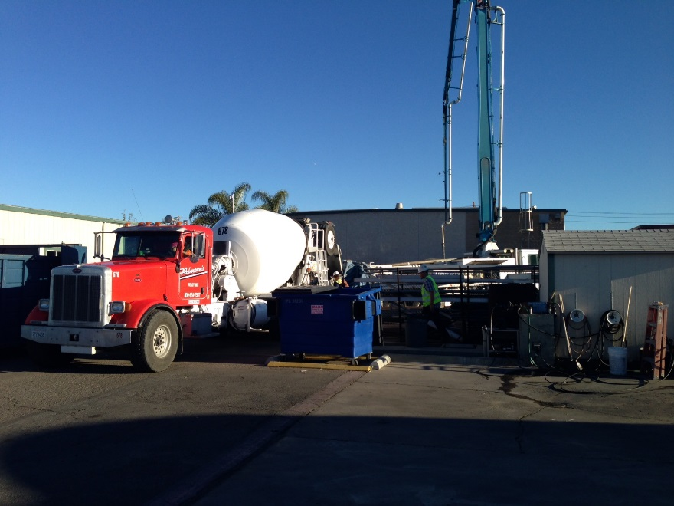
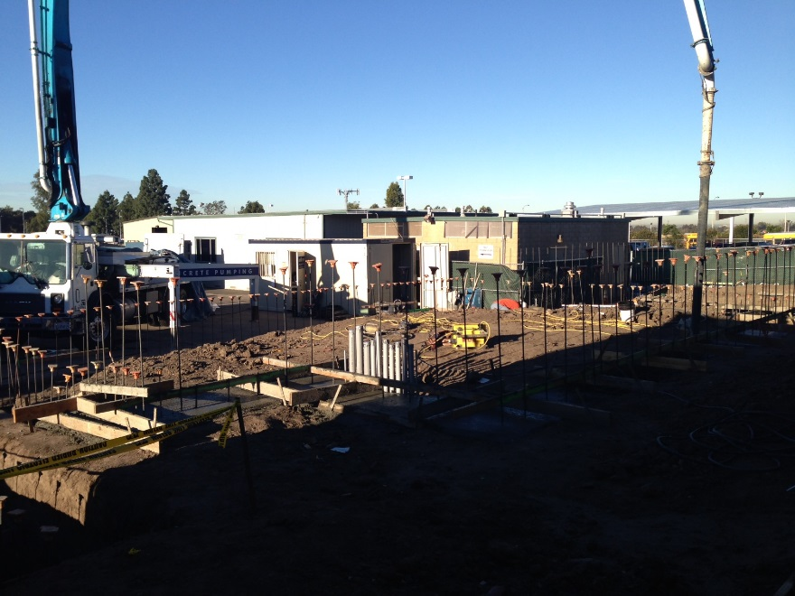
Infrastructure
Data Center
Est. Completion May 2014
WAN
Pre-Work Underway with ATT
Hardware Bid Spring 2014
Est. Completion July 2014

Slide 10
Telecommunications
All but 11 Sites on Unsupported Hardware/Software
Interaction Effects between Versions
Risky and Problematic Installs of New Sites
Beginning Upgrades in February
Goal- Stabilization
Two sites/week:
Day 1- Pre Work
Day 2 Cutover (Site offline at 4pm)
Day 3 Support
Blue Violet Networks

Slide 11
Security/Systems Admin

Slide 12
PII – Personally Identifiable Information
Username or Email Address in combination with the Password or Security Question/Answer that would permit access to an online account.
For example, these questions include the common “What is your mother’s maiden name?” types of questions” used for online self-service password resets.
First Name or First Initial + Last Name in combination with any one or more of the following:
Social Security Number
Driver’s License Number or California ID Card Number
Medical Information
Health Insurance Information
Username or Email Address along with a Password or Security Question/Answer that would permit access to an online account.
Account Number or Credit/Debit Card Number in combination with any Security Code, Access Code or Password that would permit access to someone’s financial account.
First Name | Last Name | Medications
Bob | Smith | Albuterol
Jane | Doe | Gabapentin

Slide 13
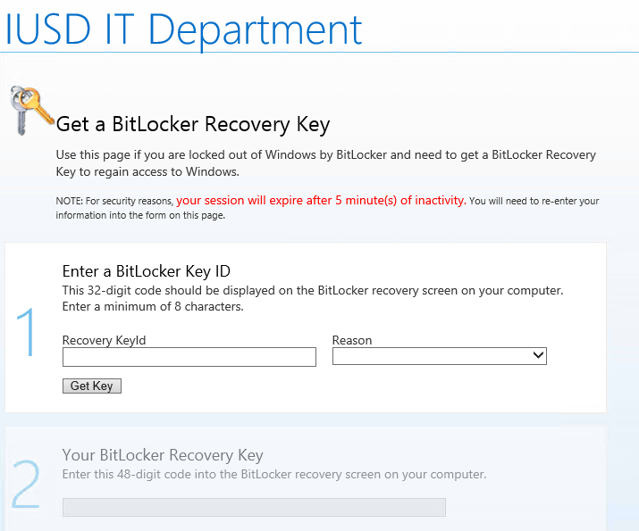
MS Bitlocker Administration and Monitoring
Whole Hard Disk Encryption
Central Key Management
Help Desk and Self Service Recovery
TPM – Trusted Platform Module
Off – we need on
In Process now

Slide 14
Updates
Guidance Encase Enterprise – Forensics
HP Arcsight Logger – Long Term Log Management and Querying
Active Directory upgrade – Windows Server 2008 R2 to Windows Server 2012 R2
WSUS Server Replaced – Windows Server 2012 R2
Windows Applocker for Malware and “Hacking” Tools
Core Hyper-V Infrastructure Upgrade
MS Advanced Group Policy Management

Slide 15
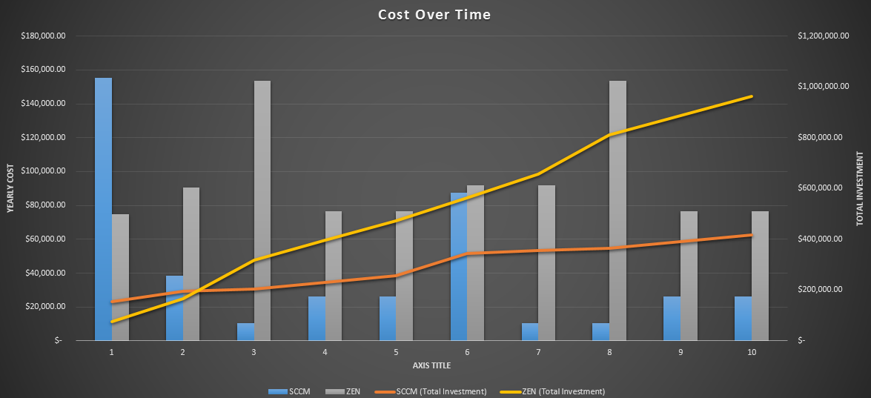
ZEN to MS SCCM
Cost Analysis Complete
Core Hardware Purchase Underway
Microsoft Funding and Support Pending

Slide 16
Next Meetings
Date | Location
February 20 | Deerfield
March 13* | Northwood High
April 10* | TBD
* Dates Changed

