Slide 1
LAN Admin Meeting
February 20, 2014

Slide 2
Agenda
Agenda Item
Staffing Changes
SBAC/Common Core
Technology Bond
Project Updates
Security/Systems Administration

Slide 3
Staffing/Support Changes
Ed Tech –
Kelly Connor (from Operations)
Media/Web Developer (Common Core)
PC Services Ongoing Restructuring
Lead Tech Role (Position Closes Today)
Help Desk
Site Need Evaluations
SIS Operations

Slide 4
SBAC/Common Core
Since last meeting….
Administrator Manual Released
Principal Meeting Presentations
Testing Time Details Provided

Slide 5
Testing Times
Excerpted from the California Online Field Test Administration Manual – Smarter Balanced Assessment Consortium. Times for students taking portions of both content areas vary slightly (within 30 mins/test) of these numbers.

Slide 6
Device Reminders
Secure Test Browser on Every Machine that will be Used
Check Connectivity in a “Real” Environment
Communicate Availability of Lab/Machines
Headphones and Sound Check Prior to Test Start
iPads- Tethered Keyboard Required
Chromebooks- Must be Managed by IUSD GAFE
Wireless – Must be WiFIUSD (not Guest)
Allow Sufficient time for Hardware Orders and Delivery
Logon Efficiencies – Generic Account, LANSchool

Slide 7
Activity
Concerns and Questions regarding SBAC
Discuss in your table group
Complete forms on table
If issue is site-specific, be sure to list your site name

Slide 8
Next Steps
Comprehensive Site Readiness Checklist
Request form for on-site support
Issues Log for gathering feedback
Post-Pilot Review at future meeting

Slide 9
Technology Bond Update
Tracking Pool Results Presented at Board Meeting (Feb 4)
Decision to postpone Public Hearing
November Projections more Favorable
Competing Issues on June Election
Uncertainty Related to LCFF
Next Steps
Ongoing Dissemination of Information
District LCCF/LCAP Planning and Budget Development

Slide 10
Project Updates
Underway | Initiating
Data Center Projector Refresh Wide Area Network Data Protection/Security IT Service Standards | Telecommunications Nutrition Services Course Management System SCCM Transition Time Reporting & Sub System

Slide 11
Data Protection/Security
Laptop Encryption
Mandatory for any laptop that may contain sensitive/personal information about staff or students.
Process:
Submit a Help Desk ticket with the computer names for each of the laptops.
Network Services will push group policy/bundle.
Will require multiple restarts.
LAN Expectations:
Communicate with staff and arrange time to support all impacted laptops being encrypted.

Slide 12
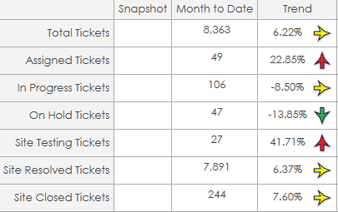
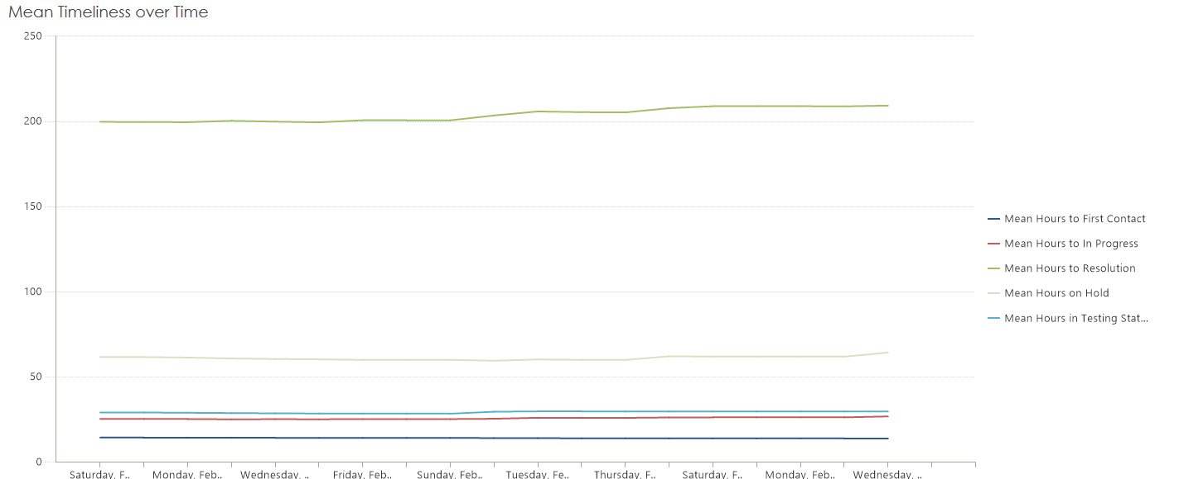
IT Service Standards
Pulls data from Help Desk and other systems to monitor responsiveness, system issues

Slide 13
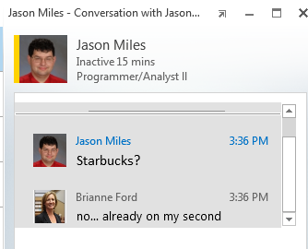
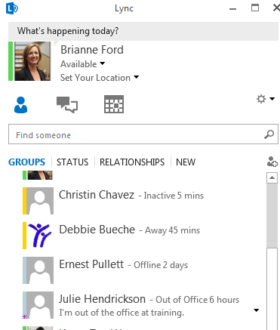
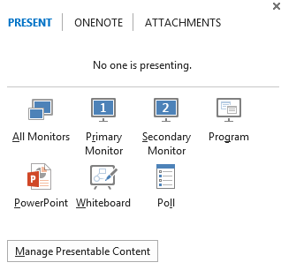
Reminder
Survey distributed for access to new MS Applications

Slide 14
Next Meetings
Date | Location
February 20 | Deerfield
March 13* | Northwood High
April 10* | TBD
* Dates Changed

