Slide 1
LAN Admin Meeting
March 13, 2014

Slide 2
Agenda
Agenda Item
SBAC/Common Core

Slide 3
Before SBAC
Testing Schedule
Student Logons
Tech Checklists
Support Requests

Slide 4
SBAC – Test Calendar
All testing dates should be emailed to Irene Brady (irenebrady@iusd.org)
Ed Services and IT have a Shared Calendar to maintain a high-level view for resource scheduling

Slide 5
March 2014

Slide 6
April 2014
Sunday | Monday | Tuesday | Wednesday | Thursday | Friday | Saturday
 |  | 1 | 2 | 3 | 4 | 5
 |  | Culverdale Rancho Oak Creek (5th gr) | Culverdale Oak Creek (5th gr) | Culverdale Rancho Oak Creek(5th gr) | Culverdale Rancho Oak Creek (5th gr)
6 | 7 | 8 | 9 | 10 | 11 | 12
 | Culverdale (makeups) Rancho | Culverdale (makeups) Rancho | Culverdale (makeups)
13 | 14 | 15 | 16 | 17 | 18 | 19
20 | 21 | 22 | 23 | 24 | 25 | 26
 |  | Vista Verde |  | Vista Verde | Vista Verde
27 | 28 | 29 | 30
 | Culverdale Vista Verde | Culverdale Vista Verde | Culverdale Vista Verde

Slide 7
May 2014
Sunday | Monday | Tuesday | Wednesday | Thursday | Friday | Saturday
 |  |  |  | 1 | 2 | 3
 |  |  |  | Culverdale Vista Verde | Culverdale
4 | 5 | 6 | 7 | 8 | 9 | 10
 | Culverdale Vista Verde | Culverdale Vista Verde | Vista Verde | Vista Verde
11 | 12 | 13 | 14 | 15 | 16 | 17
 | Culverdale Irvine High (Activity) | Culverdale | Culverdale | Culverdale (makeups) Irvine High | Culverdale (makeups) Irvine High
18 | 19 | 20 | 21 | 22 | 23 | 24
25 | 26 | 27 | 28 | 29 | 30 | 31

Slide 8
Student Logons
REMINDER: Students must be in CALPADs before they can be in TIDE.
TIDE is updated nightly, Sunday through Thursday at 10pm.
Printing Login Carts:
Testing schedules and sort order must be received at least one-week prior to when you need the cards.
If print requests arrive late, Operations will assist with providing a query for your front office to use to print onsite.

Slide 9
Student Logons and Schedules
Any issues before, during, or after the test must be reported through the Help Desk
helpdesk@iusd.org
X5060
http://helpdesk.iusd.org

Slide 10
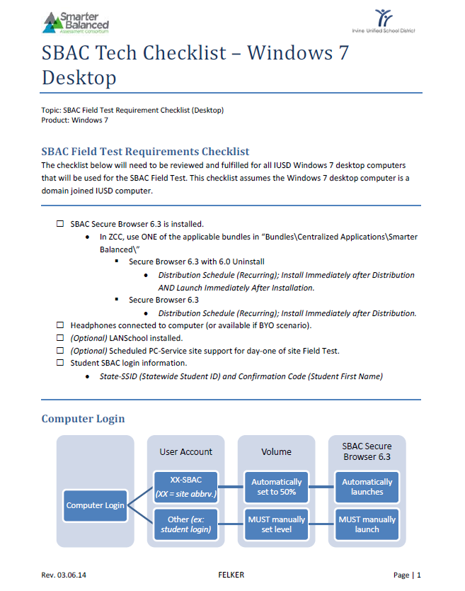
Tech Checklists
Review the technology checklist for your environment and FAQs.
Shortcuts should now be pushed out for the secure browser (students)
Shortcuts are now also pushed out for TIDE and TA for test administrators.

Slide 11
Support Requests
If you need onsite technical support during your testing window, submit the request at: http://tinyurl.com/SBAC-IUSD
You may submit multiple requests if you need more than 3-days on-site support. We have limited resources and will prioritize requests in the order they are received and based on site need.

Slide 12
During SBAC
Onsite Support
Logging In
Reporting Issues

Slide 13
Onsite Support
Make sure you have confirmed times/locations of testing with the technician that has been assigned. NOTE: During testing windows, PC Services schedules will shift to accommodate testing.

Slide 14
Logging In
Remember to use your sites SBAC login (PCs)-
XX-SBAC Username
Login will set volume to 50% and autolaunch the Secure browser

Slide 15
Reporting Issues
Any issues before, during, or after the test must be reported through the Help Desk
helpdesk@iusd.org
X5060
http://helpdesk.iusd.org

Slide 16
Site Visits
Volunteers for observers?

Slide 17
Remaining Questions/Concerns

Slide 18
Next Meetings
https://intranet.iusd.org/information_technology/LAN_Administration.html
April 10- Jeffrey Trail
May 15- University High
June 12- Eastshore

