Slide 1
LAN Admin Meeting
October 16, 2014

Slide 2
Meeting Agenda
Agenda Item
LAN and Wireless
SBAC Updates
Chromebooks, Meraki, iPad DEP
Microsoft Student Advantage
SCCM Update
Forensics Update - Visuals
Help Desk Ticket Reminders & Fun facts

Slide 3
LAN and Wireless
Why buy Access Points if DO will buy instead?
No Tech Bond, No State Tech Bond until at least November 2016
HS LAN Funded (Infrastructure/Wireless for 1:1)
Fall/Spring 2014-15 – Assessments and Bids, eRate Filing
Installation July 2015- September 2016 Wireless 1:1 @ High Schools FY 2015-2016
No Funding YET for Middle and Elementary
Earliest for Middle Schools: 2016-17
Earliest for Elementary Schools: 2017-18
Within tech refresh timelines anyway… ☹
In the meantime….
Can use Computer Matching Funds, Site Funds or Gift Funds to augment wireless
Contact Pierre for WLAN Site Survey
MUST assess wireless BEFORE any major mobile device purchase

Slide 4
SBAC Update
Start thinking SBAC thoughts!
Hardware planning and preparation:
Computer labs
WiFi & Wired Infrastructure
Purchasing considerations:
Statewide Public Test
School Matching Funds (SBAC/Common Core already infused)
Dell Chromebook Delays
Zeina Ammar
SIGMAnet
ZAmmar@SIGMAnet.com

Slide 5
Chromebooks

Slide 6
Chromebooks
Admin Console
Organizational Units corresponding to school sites
Active Directory Sync GAPS and GADS
Control of settings/preferences/policies within OU’s
Limitations
Tracking down Chromebooks which do not have location Tagged
School sites must buy management licenses for donated devices

Slide 7
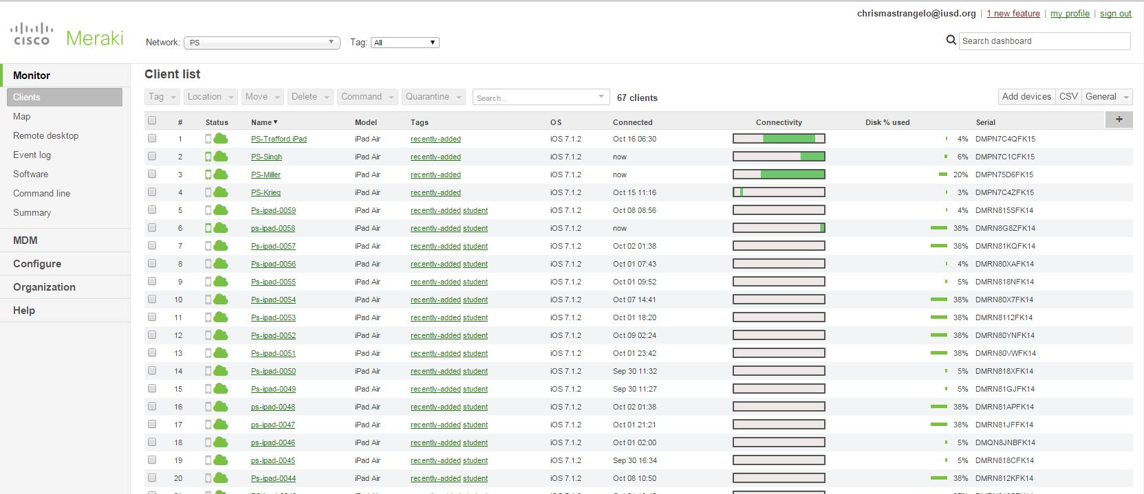
Meraki

Slide 8
Meraki
Device Enrollment Program (DEP)
Testing piloting at CY and PS
Process for enrolling new and old iPads
Benefits, process for moving forward
WiFi Considerations – Overall WiFi health at sites
Initial iPad setup

Slide 9
iPad DEP Setup

Slide 10
iPad setup

Slide 11
iPad Setup

Slide 12
iPad setup

Slide 13
iPad setup

Slide 14
iPad Setup

Slide 15
iPad Setup

Slide 16
iPad setup

Slide 17
iPad Setup

Slide 18
iPad Setup

Slide 19
iPad Setup

Slide 20
iPad Setup

Slide 21
iPad Setup

Slide 22
iPad Setup

Slide 23
Microsoft Student Advantage www.aka.ms/iusd

Slide 24
Teacher Advantage?

Slide 25
SCCM – Where are you?

Slide 26
Arcsight Logger

Slide 27
Arcsight Logger

Slide 28
Guidance Encase (Forensics)

Slide 29
Help Desk Ticket Reminders & Fun facts
Divide separate issues into separate tickets for routing and expediting purposes
Avoid putting usernames and passwords in the ticket
Over 5,000 tickets so far this fall
2000 since last LAN Admin meeting

Slide 30
Questions?
Next Meeting:
Cypress Village
13 November 3:30PM

