Slide 1
LAN Admin Meeting
January 22, 2015

Slide 2
Meeting Agenda
Agenda Item
Staffing Update
SBAC – Break the Network Day
iOS Project
SCCM Update

Slide 3
Staffing Update
New Technicians- Growth
Jon Krueger
Ailene Salcedo Chang
Transitions/New Roles
Nick Grange, Systems Admin I (Feb.)
Additional Positions - Backfills
Computer Support Specialist III (10 month)
Computer Support Specialist III (12 month – WHS)

Slide 4
SBAC
SBAC Reminders-
Test will be approximately 7-8 hours (double pilot length)
Sites must ensure adequate infrastructure, computers and peripherals (mice, headphones) to meet the need.
Expect delays in ordering and imaging through the end of this year.
NOW is the time to test your environment.

Slide 5
SBAC Update
Secure Browser 7.2 Bundle
Device requirements
Bandwidth
WiFi
Device Accessories (mice, headphones, etc.)

Slide 6
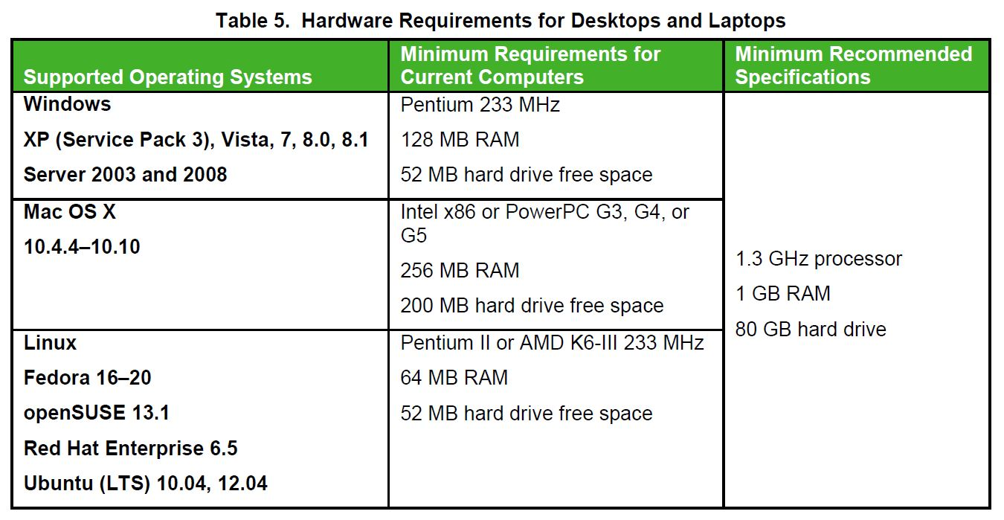
Device Guide

Slide 7
Bandwidth

Slide 8
WiFi

Slide 9
Break the Network Day: Feb 11, 9am-10am
Have as many students as you can get onto devices
Replicate testing conditions, if you can (Practice test, secure browser, etc.)
Have other teachers or students also load the system using high-bandwidth programs (Video Streaming, etc.)
Inform all staff that the network may be heavily impacted during this time.

Slide 10
iOS

Slide 11
iOS Project Update
Demystifying DEP and MDM
Project Plan
Moving forward

Slide 12
Demystifying DEP and MDM
Two ways to supervise iPads
Moving from configurator to MDM
Why?
VPP accounts for each site

Slide 13
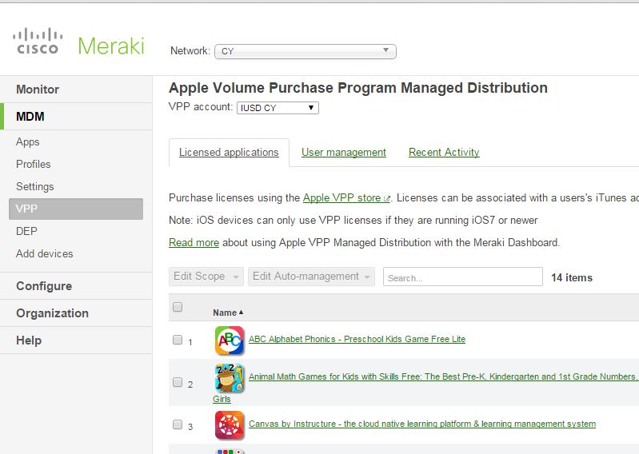

Slide 14
Project Plan
Progress and process
Site by site migration
Post conversion set up (how it will work)

Slide 15
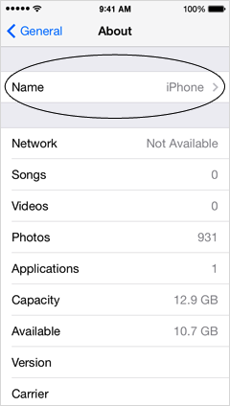
Moving Forward
Keep using current management method until migration
Understand implications of purchases before migration
What we need to for now:
Have staff create “free” Apple ID with their IUSD email
Make sure to name any new iPads in logical way:
(ab-johnsmith)

Slide 16
Project Updates- SCCM
Timeline | Milestones
December 2014 | Site Needs Assessments (Site-Wide) Back-End Infrastructure Completed
January - March 2015 | SCCM Configuration, Policy Development Pilot Sites Detailed Assessments (User-Level) Packages (Apps/Bundles) Developed and Tested Pilot Sites Implementation and Feedback
April – June 2015 | Final Schedule Developed Site Implementations

Slide 17
SCCM Update Continued
Core Components are functional
Working on a fresh Windows 7 Image, GPO
Recreating Zenworks Bundles to SCCM Formats
App-V

Slide 18
Known Issues
GAFE Passwords
Preexisting passwords set to expire on first login
Fixed by CTRL+ALT+DEL
New Accounts
Not being properly synched
Fixed by CTRL+ALT+DEL
Working with consultant to find root cause/ongoing fix

Slide 19
Next Meeting
February 19, 2015 - Greentree

