Slide 1
LAN Admin Meeting
September 17, 2015

Slide 2
Meeting Agenda
Agenda Item
Welcome and Introductions
Opening of Schools
Project Updates and Looking Ahead
Data Privacy
Q & A

Slide 3
Welcome!
LAN Admin Page: https://intranet.iusd.org/infotech/lan-admins.html
Help Desk: http://helpdesk.iusd.org
Services: https://intranet.iusd.org/infotech/services.html
Ed Tech: https://intranet.iusd.org/EdTech/
New Staff: https://iusd.instructure.com/courses/14765

Slide 4
New Team Members & New Roles
IT Operations
  Marci Boden (IT Analyst)
Tech Services
  Jonny Pearson (Systems Administrator III)
  Mare’a Armstrong (Comp. Support Spec.)
  Garrett Vogler (Com. Support Spec.)
  Chris Mastrangelo (To Network Services)

Slide 5
New Team Members & New Roles
Information Services
  Thuy Bach (Programmer)
Education Technology
  Jacob Mannaert (Database Specialist)
  Jennifer Williams (TOSA)
  Darin Nakakihara (TOSA)
  Jennifer Fritz (TOSA)
  Kiyo Nagatomi (To Library/Media TOSA)

Slide 6
Current Openings
Tech Support Supervisor
Web/Digital Media Developer (2 Positions)

Slide 7
Opening of Schools
Opening of Schools – By the Numbers
Known Issues
  Filter
    Google Image Search
    Google Translate
  SchoolMessenger – Truncating emails with attachments and links
  Skype – Brief outage this morning

Slide 8
Projects- Ed Tech
Back to School Flyer
Professional Development
  TOSAs/TACs/ETMs
Learning Object Repository (LOR)
  Kaltura
Typing Progam
  Typing Agent
Tech Plan & Policy Updates
Software Selection – Literacy, Sped Assessments

Slide 9
Projects- Tech Services
SCCM
  5,700 + Computers Reimaged this Summer
  Reimaging Staff Computers
  Moving toward Office 2013

Slide 10
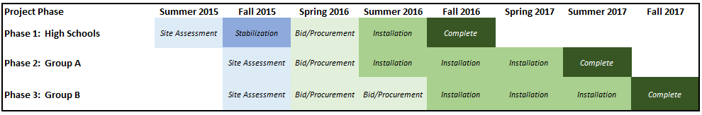
Projects- Tech Services
Local Area Network Upgrades

Slide 11
2015-16 Upcoming Projects
LCAP Additions
Visitor/Volunteer Management
Chromebooks
  ES, K8, MS – Assessment Carts:
    40 Chromebooks
    2, 36-Capacity Anywhere Slim Carts
    Headphones and Mice
    Deployment Services
  Innovation (1:1) Pilots – 60 Carts

Slide 12
Tech Matching Program Changes
Increased One-Time and Ongoing Funding
No longer a matching expenditure requirement
BUT, Principal must meet with IT Leadership
  Service and Support
  School Site Plans and Technology Needs
  BrightBytes Survey
AND, school must participate in BrightBytes survey
  Twice per year
  60% of staff and students

Slide 13
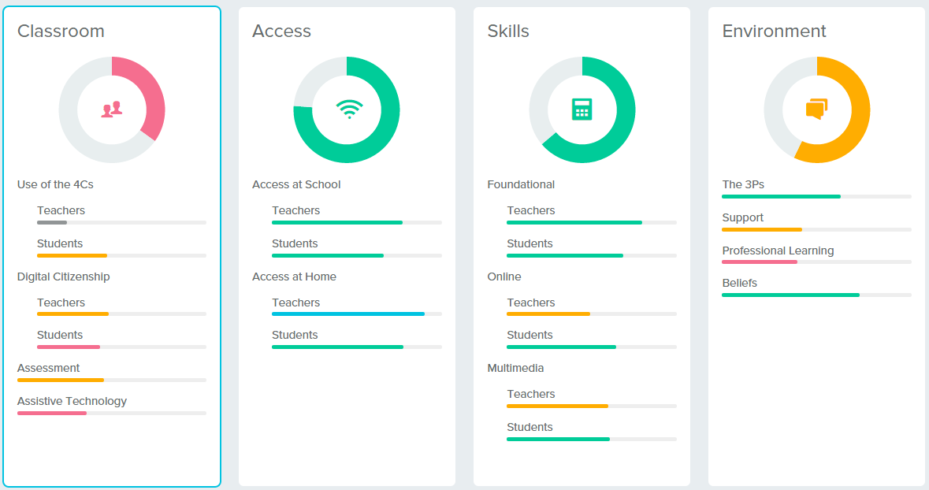
BrightBytes

Slide 14
Data Privacy
Core Concepts:
  Electronic student data should be treated with the same level of protection/caution as the students cumulative paper record.
  Data cannot be shared with any third-party without parental permission.
  The law treats entering/uploading identifiable student data to a website as if you have handed that student record to all employees of that company.
  Hosted software is a CONTRACT, not a PURCHASE

Slide 15
Data Privacy – What it Means
For all hosted/online software:
  Must have written parent permission if identifiable data are entered/uploaded.
  OR, must notify parents and have a contract that meets all the requirements of SOPIPA, FERPA, and COPPA.
  Under either circumstance, parents MUST be allowed to opt out.

Slide 16
Resources
District-Approved Software
  Contracts in place that meet the requirements
  Parent notification incorporated into re-registration process.
  Current List available at http://iusd.org/software
ALL Other Software
  Must obtain parental permission
  Sample parent letter available available from IT
Privacy Resource Intranet Page Coming Soon

Slide 17
2015-16 Meetings
October 15
November 19
January 21
February 18
April 21
May 19

