Slide 1
LAN Admin Meeting
11/19/2015

Slide 2
Meeting Agenda
Agenda Item
Project and LCAP Updates
Technology Standards
CETPA and CUE
Q & A

Slide 3
Project and LCAP Updates
Assessment Chromebook Carts
1:1 Grants
Visitor/Volunteer Management
Clever/Typing Agent

Slide 4
Assessment Chromebook Carts
ES, K8, MS
40 Chromebooks
2 Carts (36-Device Capacity)
Largest sites (WO, SG, PV, VV) receiving double.
Final deliveries this week.

Slide 5
1:1 Grant
Application sent to Leadership Team 11/13
Cohort 1:
Applications Due 12/8
Decision by 12/18
Pilot Starts Late Jan/Early Feb
Cohort 2
Applications Released Jan/Feb
Decision Feb/March
Pilot Starts April/May

Slide 6
Visitor/Volunteer Management
Pilot Sites Going Live
11/23 – Stonegate
12/1 – College Park
12/2 – Rancho
12/7 – Woodbury
12/9 – Canyon View
Will schedule additional sites early in 2016

Slide 7
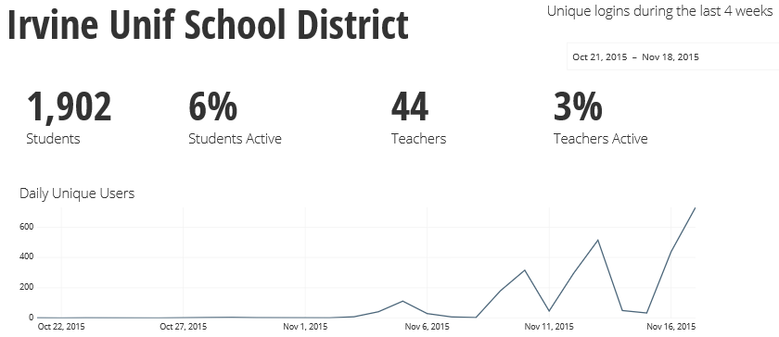
Clever/Typing Agent
EdTech email included logon instructions
Day 1: 730 Unique Users

Slide 8
LAN Project
Phase 1: HS Stabilization
Fiber completed by winter break
Equipment installed by end of January
Phase 2 & 3: Comprehensive
Bid documents being finalized/reviewed
Incremental Upgrades
Orders placed: AB, CV, DE, EA, Legacy, SP, WHS, WP, VV, TR, GR
Spring Installation
Additional needs should be submitted via Help Desk

Slide 9
Tech Standards
PO Processing Changes
Pricing Update
Standards in Adoption Process
Windows 10
Chromebook Carts

Slide 10
CETPA and CUE
CETPA
December 1-4, IT Support may be impacted
Organizational Membership Purchased
(Email Marci Boden by 11/20 to be added)
CUE
Hotel Blocks sold out
Conference expected to be sold out very soon

Slide 11
2015-16 Meetings
January 21 – IUSD Learning Center
February 18 - TBD
April 21 - TBD
May 19 - TBD

