Slide 1
LAN Admin Meeting
1/21/2016

Slide 2
Meeting Agenda
Agenda Item
New Standards Adoptions
1:1 Innovation Grants
Help Desk System
LCFF/LCAP Reminders
Q&A

Slide 3
New Standards Adoptions- Process
Paper evaluation – Is this concept worth looking into?
Unit Testing – Can we do the basics, buy it, image it, and repair it if needed?
System Testing – QA - Does the device perform as anticipated, are there issues discovered during use?
Pilot Program – Small scale test at one location to determine feasibility
Widespread Support – recommend this product as a standard for all sites, can be supported anywhere by any of our team members

Slide 4
New Standards Adoptions – Under Review
Windows Tablet
Windows Ultralight Laptop
Windows 10/Office 2016

Slide 5
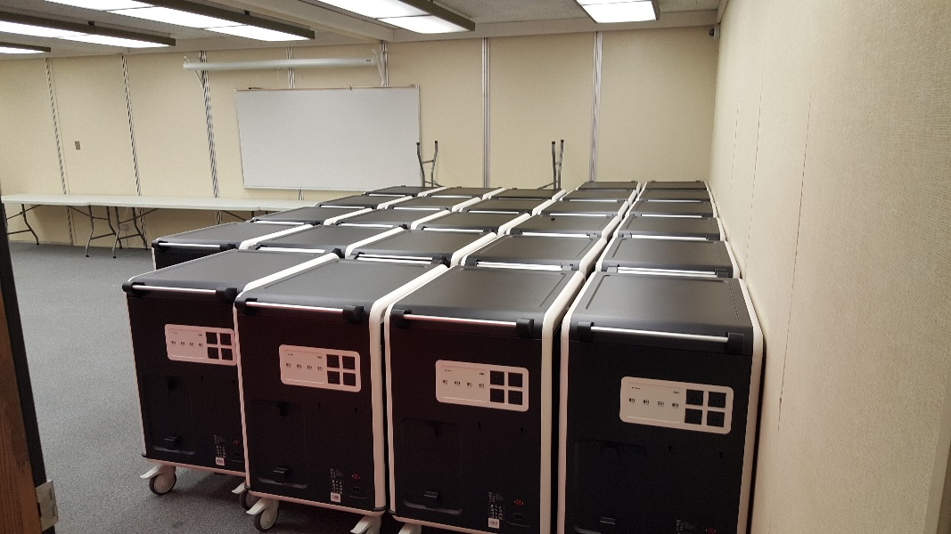
1:1 Innovation Grants
COHORT 1
COHORT 2
30 Recipients Selected
Next Steps
Training (Late Feb)
Evaluation Development (Feb)
Device Delivery (Late Feb)
Monthly Meetings/PLC Work
Open House- Next Week
Application Avail. Feb 1
Applications Due March 1

Slide 6
Help Desk System
9,270 Tickets in 2015-16 (and counting)
Current System
Inadequate to meet growing needs
Insufficient reporting
Inefficient assignment
Slow
Not accessible outside of IUSD
Cumbersome to create/assign a detailed ticket
Limited auto-assignment options

Slide 7
Help Desk System
Needs Assessment (October – December 2015)
IT Staff Meetings, site feedback, survey feedback
Evaluation of Options (October – December 2015)
Selection/Contract (January 2016)
Configuration and Testing (January – April 2016)
Pilot (May – June 2016)
Cutover (July 2016)

Slide 8
1:1 Grant
Application sent to Leadership Team 11/13
Cohort 1:
Applications Due 12/8
Decision by 12/18
Pilot Starts Late Jan/Early Feb
Cohort 2
Applications Released Jan/Feb
Decision Feb/March
Pilot Starts April/May

Slide 9
LCAP/LCFF Reminders
Budget in development now
Can propose requests through site process or IT
Funded for sites last year:
Increased support staff
LAN Upgrades
SCCM Transition (and site server replacement)
Software …

Slide 10
2015-16 Meetings
February 18 – Eastshore – LAN Admins Only*
April 21 - TBD
May 19 - TBD
*Small group budget discussion and site support needs

