Slide 1
Education for Homeless Children and Youth Program (EHCY)
Homeless & Foster Youth Liaison
Arthur A. Cummins, Ed.D.
Resources Provided By
California Department of Education
Orange County Department of Education
National Association for the Education of Homeless Children & Youth

Slide 2
Causes of Homelessness
Lack of affordable housing
Poverty
Health problems
Domestic violence
Natural and other disasters
Abuse, neglect, and/or abandonment

Slide 3

Barriers to Homeless Education
Enrollment requirements
High mobility
Lack of transportation
Lack of school supplies, clothing, etc.
Poor health, fatigue, hunger, anxiety/trauma
Lack of awareness
Prejudice and misunderstanding

Slide 4
Definition of Homelessness
The McKinney-Vento Act defines a "homeless" student as one between 0 to 22 years of age, who lacks a fixed, regular, and adequate nighttime residence, and may include:
In a house or apartment with more than one family because of economic hardship or loss
In a shelter (family, domestic violence, or youth shelter or transitional living program)
In a motel, hotel, or weekly rate housing
In an abandoned building, in a car, at a campground, or on the street
With friends or family because you are a runaway or an unaccompanied youth

Slide 5
Immediate Enrollment
Schools must immediately enroll homeless students, regardless of the lack of:
Academic Records
Proof of Residency
Medical Records
Immunization Records
Notes:
Contact the last school of attendance to obtain missing records after enrolling the student

Slide 6
School Selection
Continue at their School of Origin (the school attended when permanently housed or the school in which they were last enrolled) for the duration of homelessness; OR
Enroll in the school in the area where the family is temporarily residing (School of Residence)
If the family gains permanent housing, the student can remain at the current school for the duration of that academic year.

Slide 7
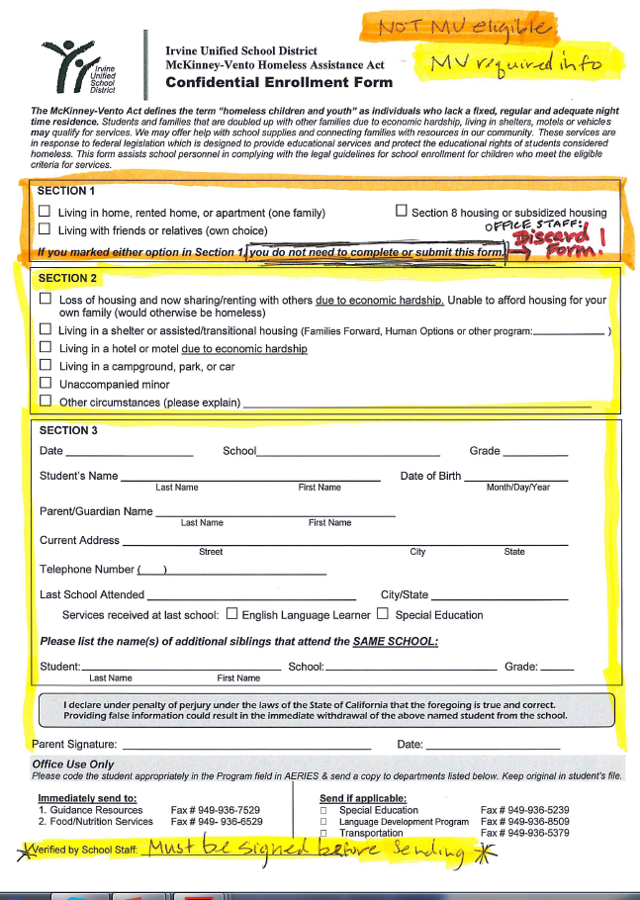
Make sure that you sign the bottom of the form before submitting it to BOTH Nutrition Services and Prevention & Intervention
Provide a copy to the school counselor so s/he can follow up with the family to offer additional support, free backpacks/school supplies and bus passes
Notes:
If the family indicates that they live in a single family home or apartment (SECTION 1), this family is not considered to be “homeless” – continue with the regular enrollment procedure. DO NOT SUBMIT THE FORM – PLEASE DISCARD FORM.
If the family indicates that they live in a home with another due to financial hardship, or “doubled up” (SECTION 2), please encourage them to complete the Co-Residency Supplemental Form to verify their co-residency status in addition to the MKVH Enrollment Form if they are able to provide it. This is not a required document and should not be a barrier to enrollment. This family is considered “homeless” – proceed with the homeless enrollment procedure.
If the family indicates that they have any other living situation described on the MKVH Form SECTION 2, this family is considered “homeless” – proceed with the homeless enrollment procedure.
If the family indicates that they have a different living situation other than the ones described on the MKVH Form in SECTION 2 “Other circumstances”, please call Department of Prevention & Intervention x 7530 to determine if the situation falls under the homeless criteria.

Slide 8
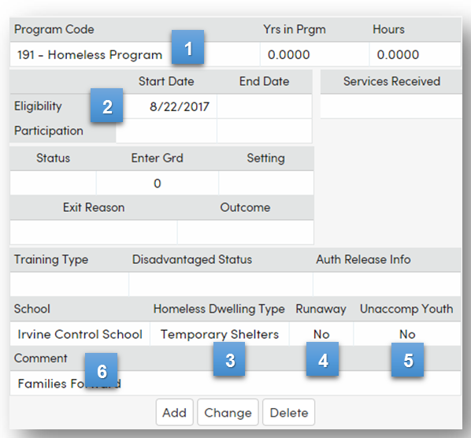
Aeries Instructions- Homeless Students

Slide 9
Contacts
Arthur A. Cummins, IUSD Homeless & Foster Youth Liaison
ArthurCummins@iusd.org
949-936-7503
Kristin Lucas, Administrative Assistant
Kristinlucas@iusd.org
949-936-7530
Jeanne Awrey, Orange County Department of Education
Jawrey@ocde.us
714-966-4093

