Slide 1
Preparing Your site for Online Testing
Kris Linville
Director, Educational Technology
Chris Mastrangelo
PC Services Lead, Information Technology
Thao Huynh
Assessment Specialist, Data and Assessment
Alyssa Honeycutt
Coordinator, Data and Assessment

Slide 2
CAASPP - What has Changed?
OLD Assessments | 2015 Assessments
CST – ELA and Math (Grades 2-11) | SBAC – ELA and Math (Grades 3-8 and 11)
CMA – ELA and Math (Grades 2-11) | SBAC with appropriate designated supports and/or accommodations– ELA and Math (Grades 3-8 and 11)
CST/CMA/CAPA – Science (Grades 5, 8 and 10)
CAPA – ELA and Math (Grades 2-11) | Alternate Assessment Field Test – ELA and Math (Grades 3-8 and 11)

Slide 3
Topics for Today:
Preparing for Online Testing
Network and Bandwidth Requirements
Hardware Requirements
Online Practice and Training Tests
Questions

Slide 4
Preparing for Online Testing
Data Readiness, Staff Coordination, and Scheduling

Slide 5
Data Readiness
The Test Information Distribution Engine (TIDE) has now been replaced with the Test Operations Management System (TOMS)
You will be receiving login information to TOMS soon!
All student information is uploaded into TOMS via the California Longitudinal Pupil Achievement Data System (CALPADS)
If you notice any errors in student data, please contact Terri Field TerriField@iusd.org
Any accommodations or designated supports are uploaded into TOMS by your site testing coordinator by March 13th

Slide 6
Staff Coordination
Planning the technology components for online testing requires close coordination and collaboration among:
Site Testing Coordinators
Media Techs
Teachers
District IT Personnel
District Testing Personnel

Slide 7
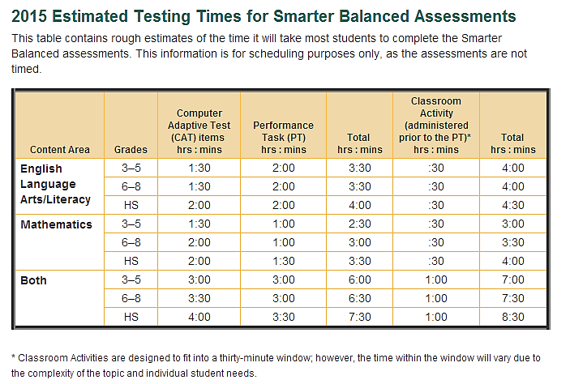
Scheduling
Your site testing coordinator will be working with you to schedule the Smarter Balanced Assessment
Allow for additional time since this test is untimed and students are allowed to take breaks.
Schedule time for make-up testing.

Slide 8
Network & Bandwidth
Network Configurations and Secure Browser

Slide 9
Network Configurations and the Secure Brower
Outgoing bandwidth to the internet has been upgraded at almost every site
IUSD’s IT department has taken care of all network configurations as well as the secure browser installation
Similar to last year, you will use LAN School to login to all the computers in the lab
The secure browser will already be installed
Chromebooks will be used in kiosk mode
The audio on all computers will automatically set to a medium volume
Students will not be able to access any additional applications or websites
Consider notifying staff that Wi-Fi use should be limited during the testing window (turn off Wi-Fi on cell phones)

Slide 10
Hardware
Requirements for Successful Testing

Slide 11
Hardware Requirements
Recommended testing devices include:
Desktop computers
Laptop computers with a mouse
Chromebooks with a mouse (Dell Chromebooks preferred over Samsung Chromebooks)
IUSD does not recommend testing on iPads at this time

Slide 12
Hardware Requirements
Headphones are required for each test station
English language arts/literacy (ELA) tests
Text-to-speech accommodation
Job Access with Speech (JAWS)
USB headphones recommended
Microphones not required
External keyboards required for tablets
Mechanical
Manual
Bluetooth-based
Avoid keyboards with additional “shortcut” buttons

Slide 13
Practice & Training tests
Preparing Students for Success

Slide 14
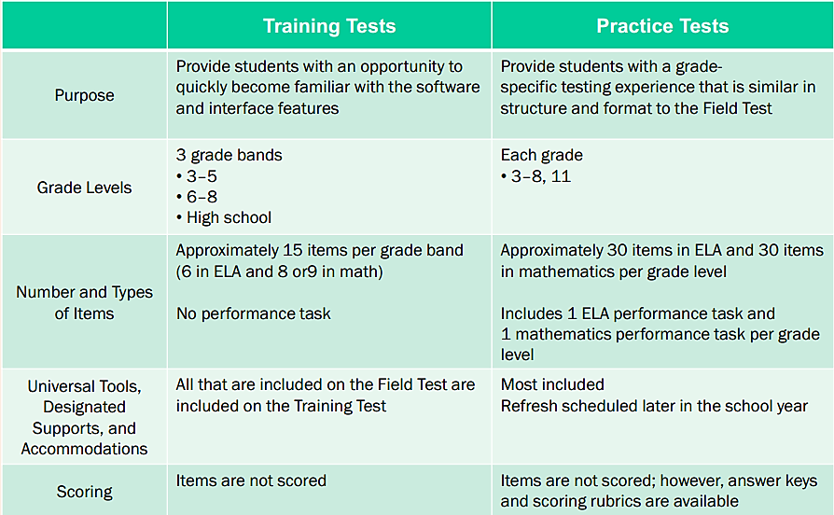
Online Practice and Training Tests

Slide 15
Online Practice and Training Tests
Available on caaspp.org and via the Secure Browser!
Training Test
Practice Test

Slide 16
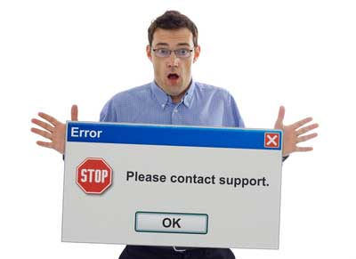
Support and Resources
CAASPP Website:
caaspp.org
Technology Readiness Resources:
http://www.cde.ca.gov/ta/tg/sa/sbac-itr-index.asp
At Your Site:
Site Testing Coordinator
Site TOSA
Site Principal
District Technology Contacts:
Kamy Tse-Wong
Chris Mastrangelo
Kris Linville
District Assessment Contacts:
Thao Huynh
Alyssa Honeycutt

Slide 17
Questions?

