Slide 1
Student Discipline
Workshop
October 25, 2019

Slide 2
Hello!
Tammy Blakely
Coordinator of Student Services
You can find me at tammyblakely@iusd.org

Slide 3
Please introduce yourself and share your job and school location.
What are 1-2 things you want to take away from the workshop today?

Slide 4
Resources
https://intranet.iusd.org/studentserv/documents/DISCIPLINEHandbookREV2018-19.pdf
Other Resources
IUSD Staff Intranet*
*Updated regularly

Slide 5
Building our Levels of Support for Sites
Student Services
Intervention & Prevention
Academic, Behavioral, Social Emotional
504
Language Development
Notes:
Student services is part of a larger support system (department) of Student Support Services. As we work on building and connecting the different parts of our department, know that we are all working to support students, families, and staff. Intervention and Prevention is Academic, Behavioral, and SEL

Slide 6
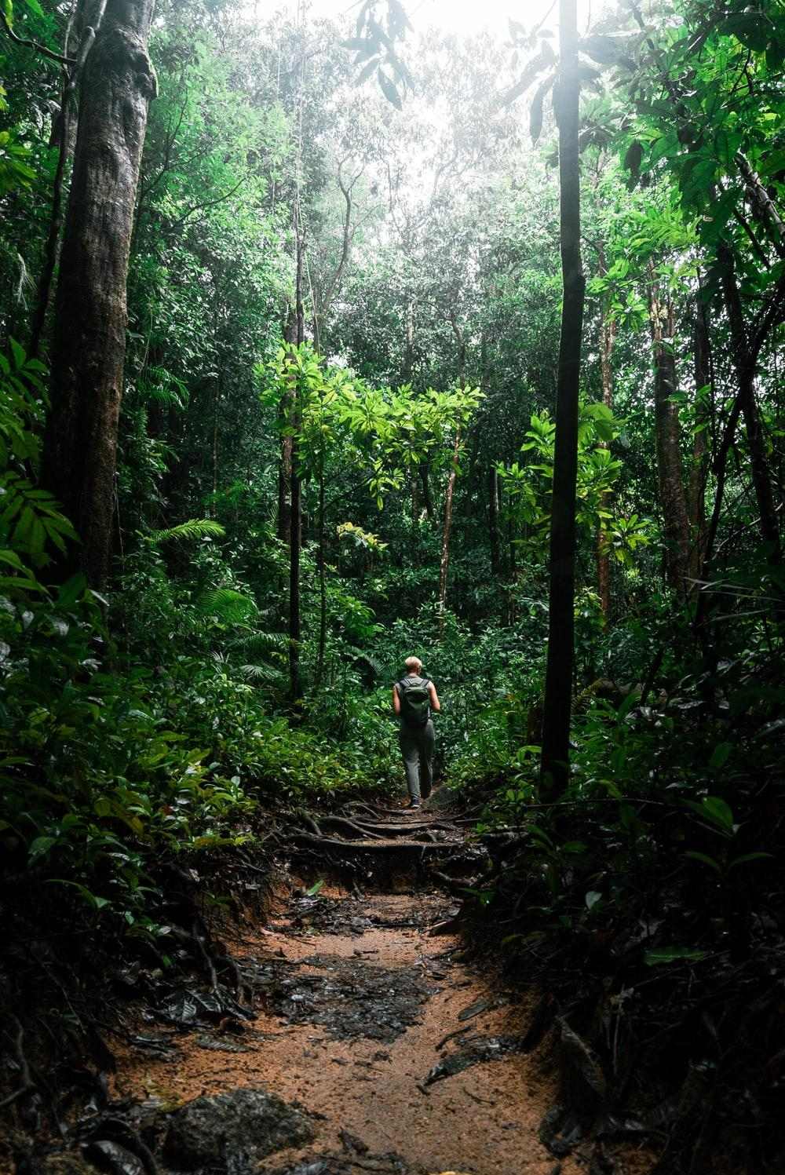
Central Tenants of Behavior
Student Behavior is Complex
Meets some need for the student
How we respond is crucial
Many ways to address behaviors

Slide 7
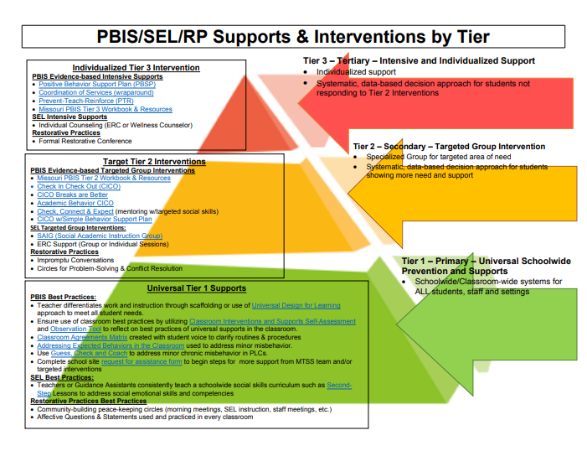
Notes:
This includes PBIS, Restorative Practices, SEL

Slide 8
PBIS Strategies
Prevention
Teach School-wide Expected behaviors for class routines
Class Syllabus
School-wide Behavior Flow Charts
Use data points
to ask the right questions to figure out the WHY
Consistent Responses
Prompt/pre-correct, Reteaching, Clarifying, Modifying task

Slide 9
Other Means of Correction
How are we guiding students?
PBIS - building relationships
Support Staff/Programs
Other alternative practices

Slide 10
What does alternative practices mean?
Restorative Practices
Implementing Positive Behavior Interventions and Supports (PBIS) Framework with fidelity
Implementing SEL Best Practices
Calm Classroom
Trauma Informed Practices
Notes:
Ask for a show of hands for anyone in the group who is using any of the alternative practices. Let group know about Restorative Practice training Dec 10, Dec 12, Mar 3 and Mar 5

Slide 11
Progress monitoring with student discipline
How do you know site practices are working?
What data are you looking at?(SWIS, Aeries, iLead/CA Dashboard)

Slide 12
NEW LAWS
SB 419 permanently bans the use of 48900 (k) for grades k-3. Temporary ban on 49800(k) for grades 4-8
Restraint and Seclusion for Gen Ed students--the definitions have changed so we need to watch this.
Notes:
The laws are changing pretty fast. We need to talk about our practices, what we are doing and how we are doing it. Are our practices supporting students changing behaviors? Shifting mindset.
This does not mean that we start using minor/major codes to get to the same desired outcome of a suspension.

Slide 13
Discipline
1
Notes:
The goal is to change student behavior, if at all possible, before it gets to the discipline level.

Slide 14
Templates and Forms
Please use the forms/templates available in Student Services tab
Witness Statement forms
Continuance of Suspension
They have been vetted by OCDE and contain necessary information

Slide 15
Table Talk
What are some hot topics that you are seeing at your school site?
What does support look like for the students? For you?
Notes:
Vaping will likely be front and center. How are we working with students who have repeated behaviors.

Slide 16
Vaping
Please share information with us.
What does support look like for you at your site on this topic?
Notes:
We are scheduling IUSD Parent education nights for Vaping. They are November 13 and December 3 from 6-8 pm. We will be sharing information on location as soon as it is available.

Slide 17
Discipline Coding

Slide 18
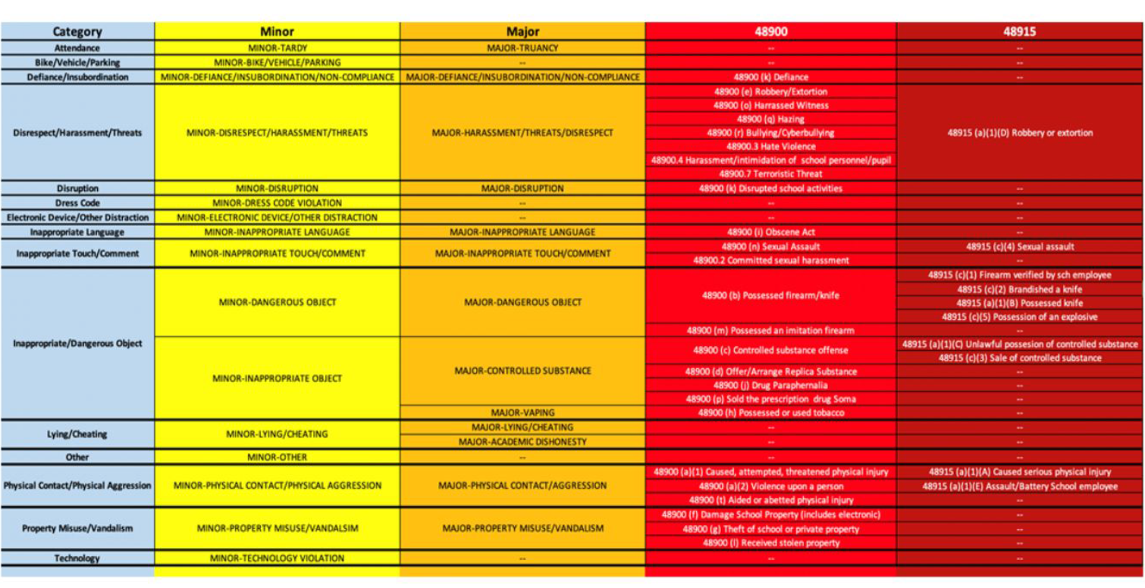
Notes:
NOTE: You should NOT be suspending students using a MAJOR code. If you are going to suspend a student, you need to use a suspension code. Other means of correction applies for Suspension codes beyond a-e

Slide 19
Use minor/major codes as needed to accurately identify the behavior
Use the iLead dashboard to analyze data from discipline entries
It is important to document trends/patterns in behavior
Show other means of correction
Notes:
FYI - Minor - as defined in PBIS work--is when you have to STOP INSTRUCTION, get the class working independently, and have a private conversation with a student
We encourage the entire staff to define what minor vs. major looks like for each common problem behavior by doing a full staff activity - T-charts where staff define (what would you see, what would you hear) for disruption minor/major, disrespect - minor/major, etc. and then have the PBIS/MTSS team compile the results, come to agreement as a staff, and the next step is to come to agreement with best practices as to how we respond when minor and major problems occur. That is then when they create the active flowchart.

Slide 20
Behavior Contracts
Provide a path for student to make changes in behavior (+/-)
Document efforts
Outline specific parameters for student/parents
Make it specific to issues/concerns
CLEAR IS KIND
DON’T
Make promises (or threats) you can’t keep
Make general statements that are unclear
Use behavior contracts FIRST (try Tiers 1 & 2 before a contract--these are really a Tier 3 support (individualized)
Notes:
Identify the playing field for students and parents. Let them know the parameters for behavior. Also, talk about what can be gained, not just lost with the behavior contract. Behavior contracts are for students with tier 3 (red) behaviors.

Slide 21
Nexus to school
Can the behavior be connected to school or a school sponsored activity?

Slide 22
Off Campus Conduct
Question:
Does the district have jurisdiction to discipline students engaging in off-campus conduct?
Answer:
Where the district is unable to document facts that show the conduct is related to school activity or school attendance, the courts have not upheld the discipline.

Slide 23
The Right Questions Matter
Notes:
Is this where Restorative Questions can be used?
To respond to challenging behavior:
What happened? What were you thinking at the time?
What have you thought about since? Who has been affected by what you have done? In what way?
What do you think you need to do to make things right?
To help those harmed by others’ actions:
What did you think when you realized what had happened?
What impact has this incident had on you and others?
What has been the hardest thing for you?
What doyou think needs to happen to make things right?

Slide 24
Suspension
2

Slide 25
What to keep in Mind
Have there been other means of correction documentation?
SPED or 504 Student?
Provide the opportunity for student to share his/her side of the story (Due Process)
We have a checklist of suspension codes we will share with you.

Slide 26
Narrative on Suspension Notice

Slide 27
What is necessary?
Short statement of facts. No opinions please
Grammar and spelling matter
Educational Records (parents can request the record)
Discipline history
Notes:
If you want to add more detail, please complete an administrative statement. This statement can help fill in detail. Very important, the expulsion packet is information that will be shared with parents. Keep this in mind as you are writing and completing the investigation

Slide 28
If you want to add more information...
Administrative Statement

Slide 29
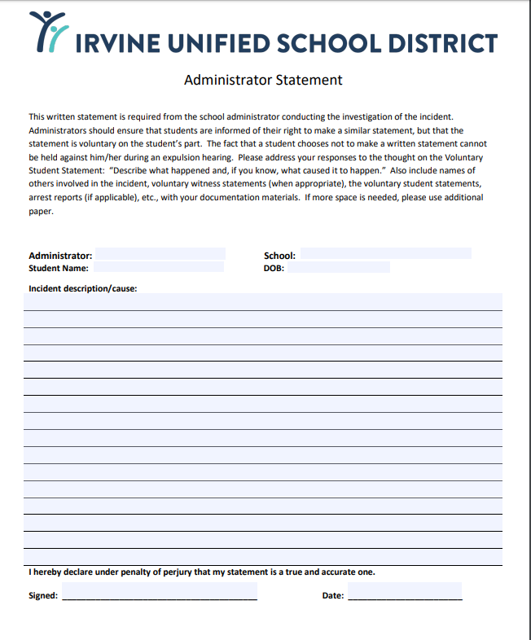
Example of an Administrative Statement
* IUSD staff intranet

Slide 30
ADMINISTRATIVE STATEMENT

Slide 31
Expulsion
3

Slide 32
What should the Administrative Statement contain?
Thoroughly investigate the facts
It is important to understand the scope and context of the violation.
Interviews
All persons involved, asking specific questions to determine if violation occurred. This includes providing the opportunity to write a statement.
Notes
Should be taken of each of the interviews and written statements should be prepared for the witnesses to sign.
Facts from Investigation
All physical evidence should be preserved. Including
Weapons, drugs, printouts of webpages, photographs
Based on the investigation of facts, the administrator should make a determination as to whether
A violation has occurred, which EC provision was violated, Who committed the violation

Slide 33
Connecting the dots is extremely important. Details matter.
Notes:
This can be the most frustrating part when you are at the school site. Please know that when I am asking questions or requesting seemingly unimportant details, I am trying to support your recommendation for expulsion by helping you build a case. Expulsion process is driven by Education Law and there are technical steps and details that matter. Please be patient and know that I am not questioning your professional decisions or judgement. I am doing everything I can to build the case and support your recommendation or request. Reiterate, parents are entitled to have the information you will be presenting at the expulsion hearing. Keep that in mind as you are compiling statements.

Slide 34
Expulsion Hearing Panels
Are you interested in participating?
Notes:
Talk about attending an OCDE county training that talks about discipline and expulsion hearing panels. Expulsion hearing panels are administrative law hearings that are technical.

Slide 35
What do you need?
Resources
Training Topics
Experiences

Slide 36
Highly Recommend
ProAct Training

Slide 37
Thanks!
ANY QUESTIONS?
You can find me at
Tammyblakely@iusd.org
Ext. 5171

